Slide 1
Vitesco Boot Concept
Go Through
11.30.2021

Slide 2
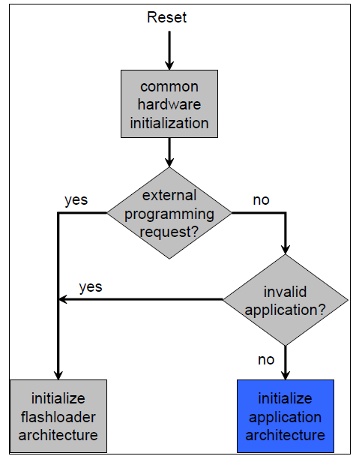
bootloader
prepare
>This is used to reprogram ECUs App software
>General program flow

Slide 3
Preface
Will and Will Not
This session is intentionally to introduce boot concept of HGIF (for both ECU14 and ECU17) in a higher level.
Detail can be found in attached official training material.
It will cover
Different units such as boot manager, boot loader, end user application, and how to jump between
Common use cases
It will not cover
Reprogramming (for example, command, sequency, check, flash driver, …)
Uds service
Note:
EMS3: 3rd 32bit ECU which includes
AutoSAR Architecture (PowerSAR),
MultiCore
New Boot Concept
Basic SW (GIF, HGIF):
Chip Set (ECU14, ECU17, …)
ECU 14: Aurix (TC2xx), ATIC1XX,
ECU 17: Aurix 2G (TC3xx), ATIC2XX,

Slide 4
RunTime Units
Overview
Confluence Link:
Build Units - EMR3 PSA SW - Vitesco Technologies Confluence
RunTime Unit
Build Unit
Smallest autonomous executable entity (e.g. Boot Manager, End-User Application)
made of one or more parts
made of one or more sub units
made of one or more programming units
Smallest buildable entity (e.g. RC0, 0A0)
produces exactly one RunTime Unit part
Sub Unit
Programming Unit
Logical subdivision of a RunTime Unit (e.g. Applicative Software, Dataset, Postbuild block and Mapping Block are 4 sub units of the End-User Application)
made of one or more programming units
Smallest programmable entity (also referred as slot for multi-part application)
always shipped with prolog and epilog
always aligned on one or more sectors

Slide 5
RunTime Units
overview
RunTime Unit | Build Unit | Sub Unit | Comments
0M0
 |  | LM0 | LIF， Part of 0M0
0L0
 | RC0 |  | Add-On, Customer, IL0
 | XC0 |  | Add-On, Customer, IL0
 | EC0 |  | Add-On, Customer, IL0
 | WS0 |  | Add-On, Supplier, IL0
0U0
 |  | 0A0 | Application SW
 |  | 0D0 | Data Set
HA0 |  |  | Added in HGIF17
HM0 |  |  | Added in HGIF17
1L0 |  |  | SBOOT, Added in HGIF17

Slide 6
Bootloader Related tool
HW & SW
Addon | Protocol | HW | PC SW | Comments
RC0 | UDS | VECTOR HW | HEV Flash Tool or CAN Tool | Customer HW/SW tool supported
XC0 | XCP | ETAS HW | INCA/ProF | Only used in development phase
WS0 | STP | CXS （new），PHS （old） | CoReDo （from SSP7） | Used by VT’s WRC to dump, reflash
SBOOT | ??? | CoPra | ECU Test Suite (Green SW) | From BU T and now integrated to EMS3
Standalone SBOOT
EMR3 is using this solution
Sboot + TSW, totally independent to EMS3 Boot concept
PowerSAR SBOOT (1L0)
A12: ongoing, will connect to Cypro Server
GWM: not planned

Slide 7
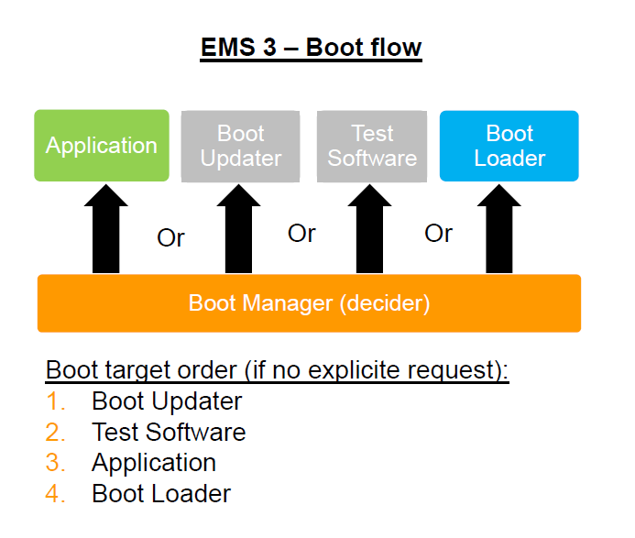
EMR3: Boot flow
flow

Slide 8
Emergency Entry
Introduction
What is the Emergency Entry function?
One Way to enter to the Supplier Reprogramming Session mode
Required for Extended Supplier diagnostics (e.g warranty return -> WS0)
Typically required to update the Boot Loader
Can be applied also in case of damaged Boot Updater, if Boot Loader plus EC0 addon still present in the ECU
Emergency Entry does not compromise Security
Emergency Entry is NOT related to Safety
Boot Manager is offering two different ways of using EEntry:
Pin detection based,
Communication message based (only CAN is supported)

Slide 9
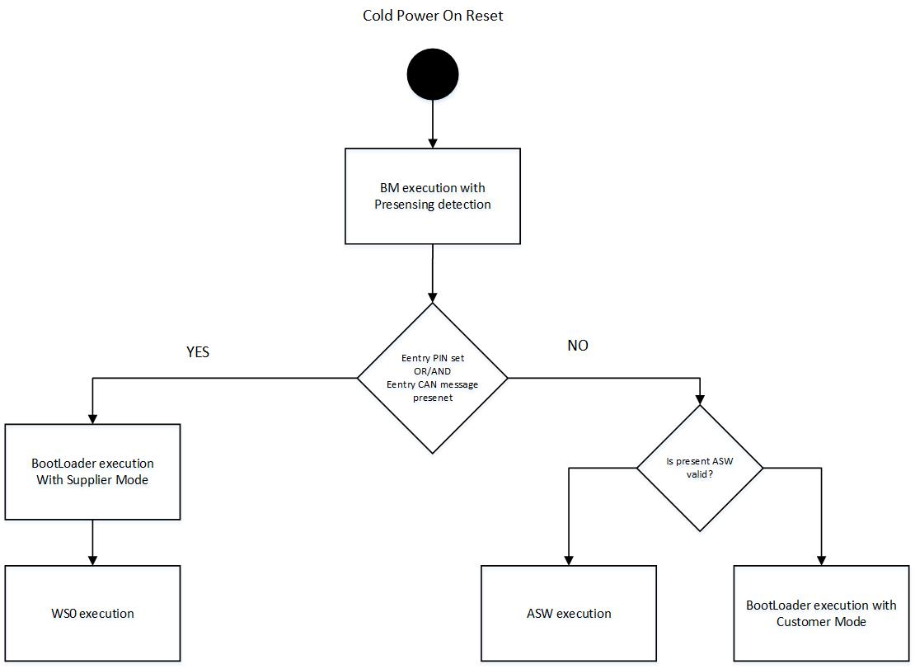
Emergency Entry
EMS3 Boot Flow complete
EEntry validation is
mandatory to reach
this state (EC0 or 1L0)

Slide 10
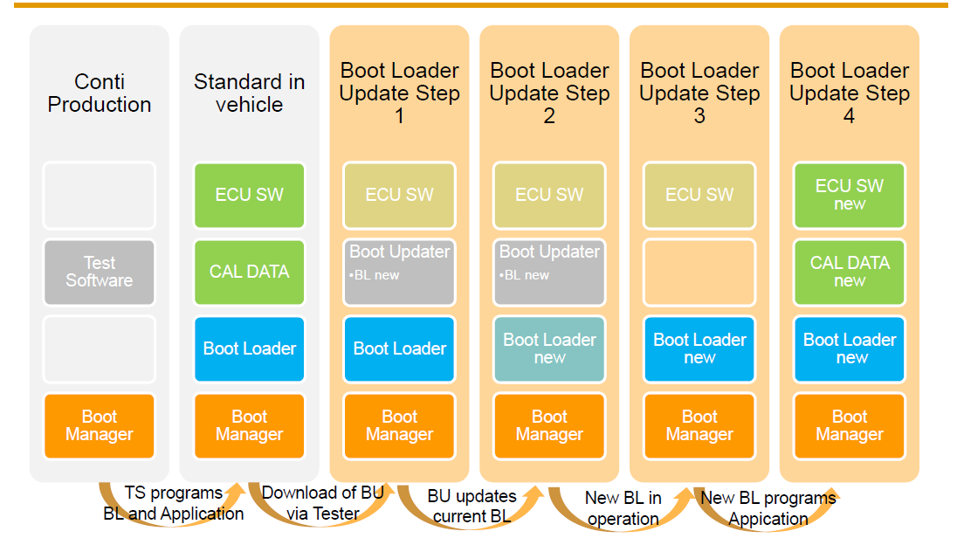
EMR3 boot concept
Lifecycle example

Slide 11
Any questions?

